Slide 1
DOCUMENT SUMMARIZATION WITH VHTM: VARIATIONAL HIERARCHICAL TOPIC-AWARE MECHANISM Xiyan Fu, Jun Wang, Jinghan Zhang, Jinmao Wei, Zhenglu Yang published IN AAAI-20
Presenter: Emanuele Giuseppe Maria Maita

Slide 2
Automatic text summarization
Automatic text summarization distills information from long texts into a shorter ones for convenient understanding.
It has provided great benefits for many natural language processing tasks, such as text classification, information retrieval and question answering.
Summarization approaches in the literature can be roughly categorized into three groups:
extractive-based models, where summarization is seen as the extraction of key sentences and objects without modification;
abstractive-based models, which paraphrase the content-related sentences verbatim after comprehending the original document;
unified models, which combines the two mentioned approaches by utilizing the respective strengths. That is, they can copy words from original documents and generate novel words simultaneously.

Slide 3
Topic awareness
A significant drawback of the aforementioned studies is the ignorance of topic information, which is deemed as the most important signature of documents.
Topic-aware models are introduced to tackle these limitations: topics serve as guidance to help generating abundant topic-related words and maintain the original ideas of documents.
Most existing deep learning-based summarization works are assisted by an external topic model, e.g. Latent Dirichlet Allocation.

Slide 4
Weaknesses of external topic models
Summarization is done based on externally generated topics, which may neither characterize the flavor of the text nor satisfy the requirement of the task.
LDA is performed under the assumption that topics are drawn from multinomial distributions across the text: this does not hold for all text fetched from different domains; moreover, it extracts all latent topics, not only the most informative ones.
An established belief in summarization is that different paragraphs typically possess distinct levels of importance: using these models pre-trained topics are instead fetched at document level, excluding sub-topics hidden in paragraphs.

Slide 5
Proposed approach
The authors introduced a deep learning model equipped with a VHTM, which stands for:
Variational: it is based on a variational encoder-decoder framework;
Hierarchical: paragraph-level and document-level topics are induced to capture local and global semantic and syntactic information of a document;
Topic-aware: the topic inference model and the summarization model are trained end-to-end (it does not resort to an external topic model).
Mechanism.
It’s the first attempt to jointly accomplish summarization with topic inference via variational encoder-decoder and merge topics into multi-grained levels through topic embedding and attention.

Slide 6
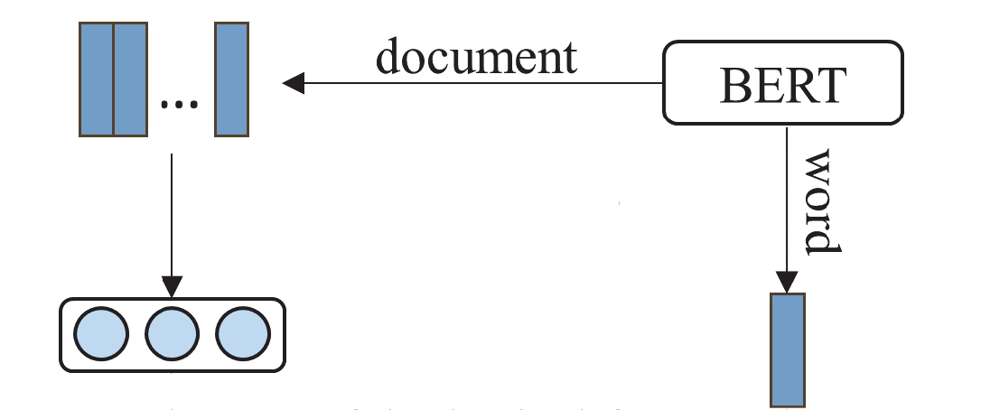
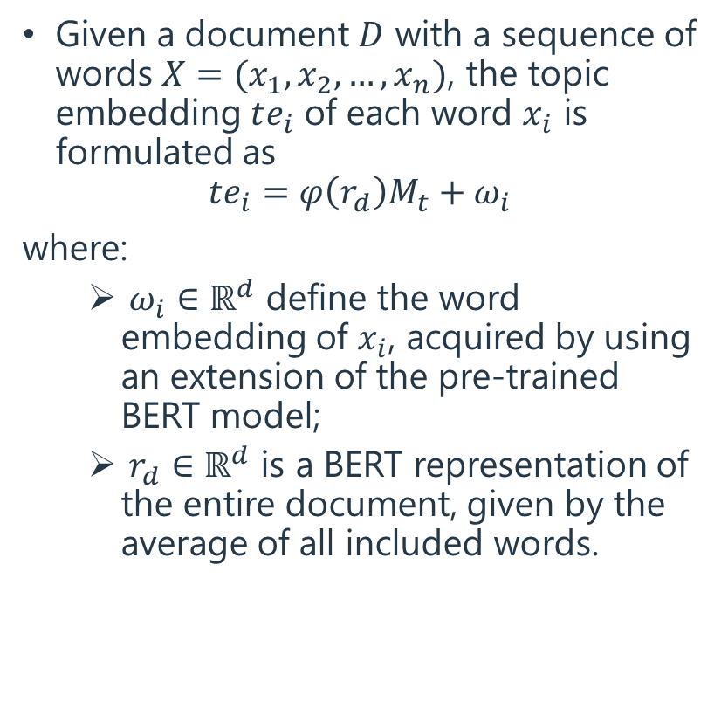
Topic embedding (1)
Given a document $D$ with a sequence of words $X={(x}_{1}, x_{2},…, x_{n})$, the topic embedding $te_{i}$ of each word $x_{i}$ is formulated as
$$te_{i}=φ\left(r_{d}\right)M_{t}+ω_{i}$$
where:
$ω_{i}∈ℝ^{d}$ define the word embedding of $x_{i}$, acquired by using an extension of the pre-trained BERT model;
$r_{d}∈ℝ^{d}$ is a BERT representation of the entire document, given by the average of all included words.

Slide 7
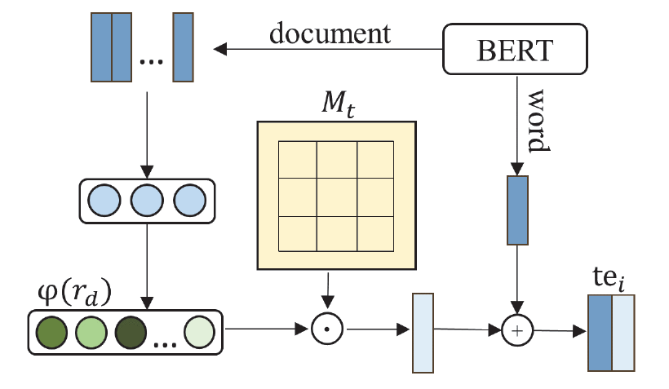
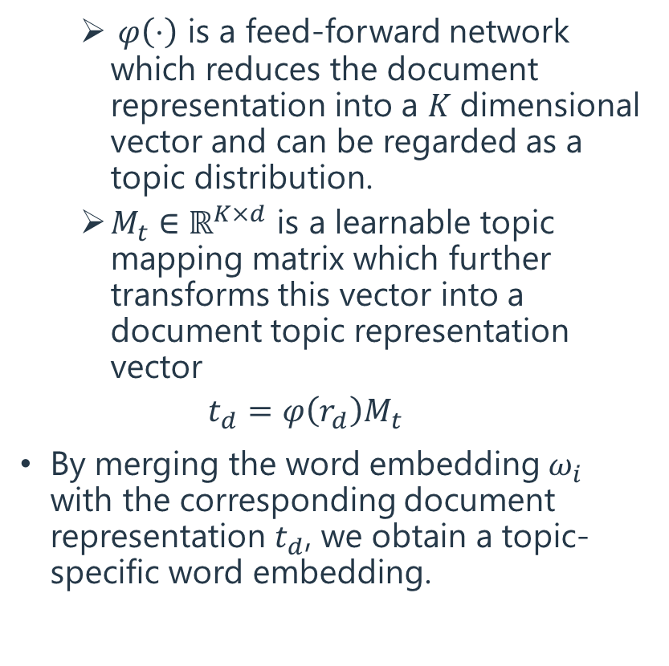
Topic embedding (2)
$φ\left(⋅\right)$ is a feed-forward network which reduces the document representation into a $K$dimensional vector and can be regarded as a topic distribution.
$M_{t}∈ℝ^{K×d}$ is a learnable topic mapping matrix which further transforms this vector into a document topic representation vector
$t_{d}=φ\left(r_{d}\right)M_{t}$
By merging the word embedding $ω_{i}$ with the corresponding document representation $t_{d}$, we obtain a topic-specific word embedding.

Slide 8
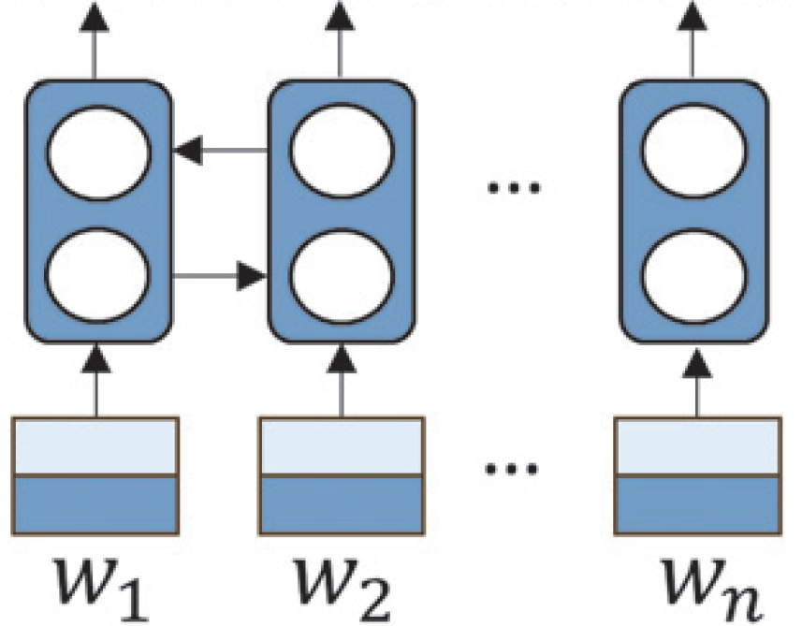
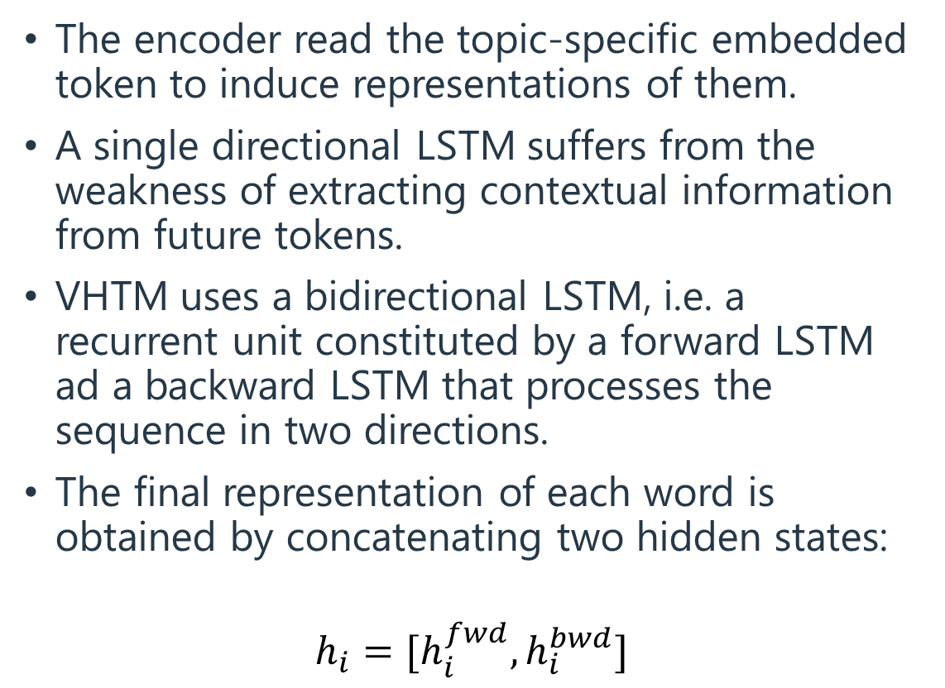
Encoder (BiLSTM)
The encoder read the topic-specific embedded token to induce representations of them.
A single directional LSTM suffers from the weakness of extracting contextual information from future tokens.
VHTM uses a bidirectional LSTM, i.e. a recurrent unit constituted by a forward LSTM ad a backward LSTM that processes the sequence in two directions.
The final representation of each word is obtained by concatenating two hidden states:
$$h_{i}=[h_{i}^{fwd}, h_{i}^{bwd}]$$

Slide 9
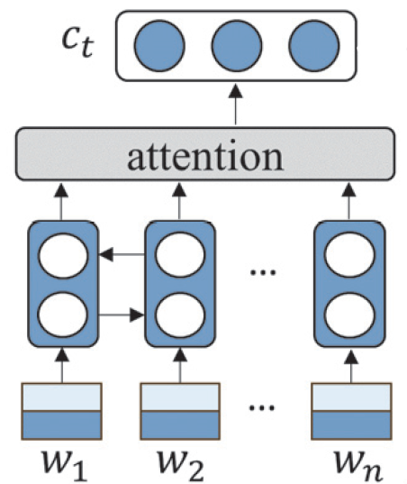
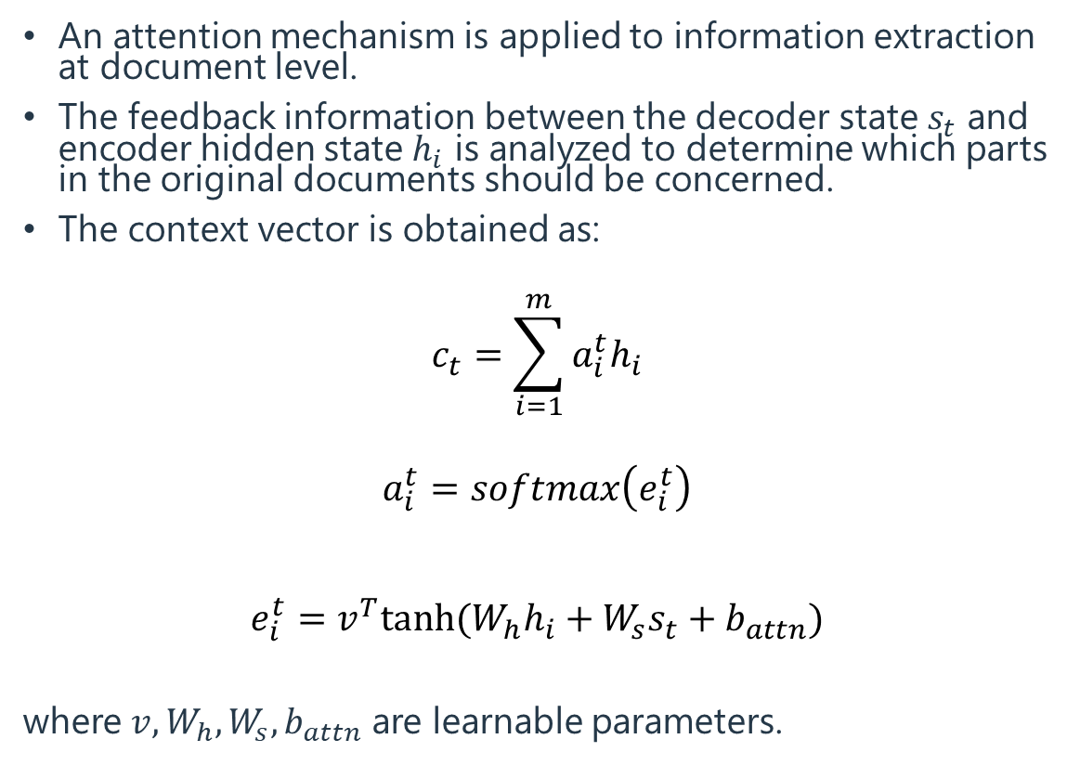
Encoder (attention)
An attention mechanism is applied to information extraction at document level.
The feedback information between the decoder state $s_{t}$ and encoder hidden state $h_{i}$ is analyzed to determine which parts in the original documents should be concerned.
The context vector is obtained as:
$$c_{t}=\sum_{i=1}^{m}{a_{i}^{t}h_{i}}$$
$$a_{i}^{t}=softmax\left(e_{i}^{t}\right)$$
$$e_{i}^{t}=v^{T}tanh⁡({W_{h}h}_{i}+W_{s}s_{t}+b_{attn})$$
where $v, W_{h}, W_{s}, b_{attn}$ are learnable parameters.

Slide 10
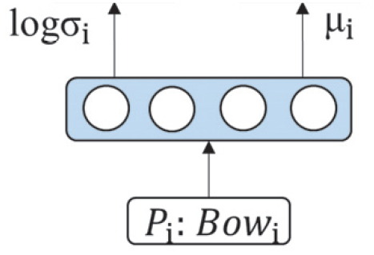
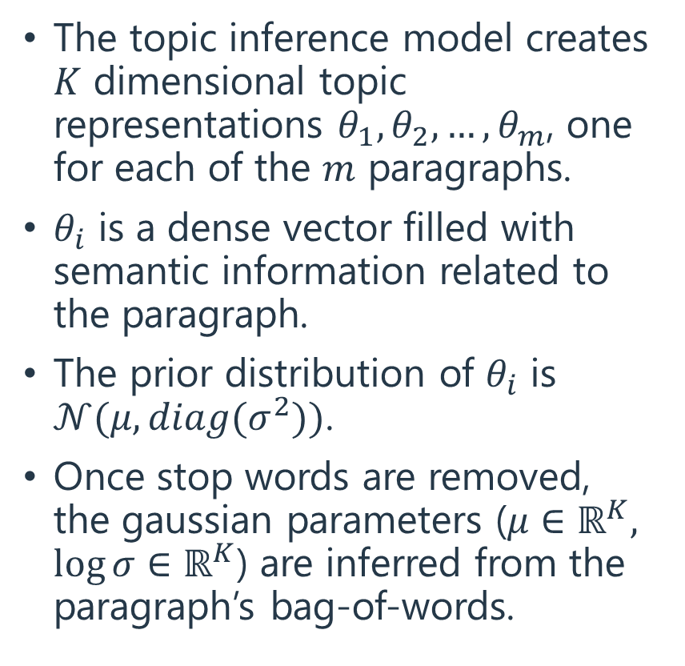
Topic inference (1)
The topic inference model creates $K$ dimensional topic representations $θ_{1},θ_{2}, …,θ_{m}$, one for each of the $m$ paragraphs.
$θ_{i}$ is a dense vector filled with semantic information related to the paragraph.
The prior distribution of $θ_{i}$ is $𝒩(μ, diag(σ^{2}))$.
Once stop words are removed, the gaussian parameters ($μ∈ℝ^{K}, \log{σ}∈ℝ^{K}$) are inferred from the paragraph’s bag-of-words.

Slide 11
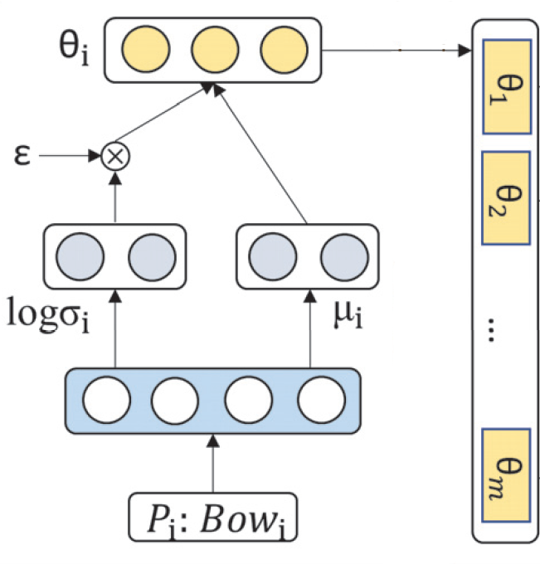
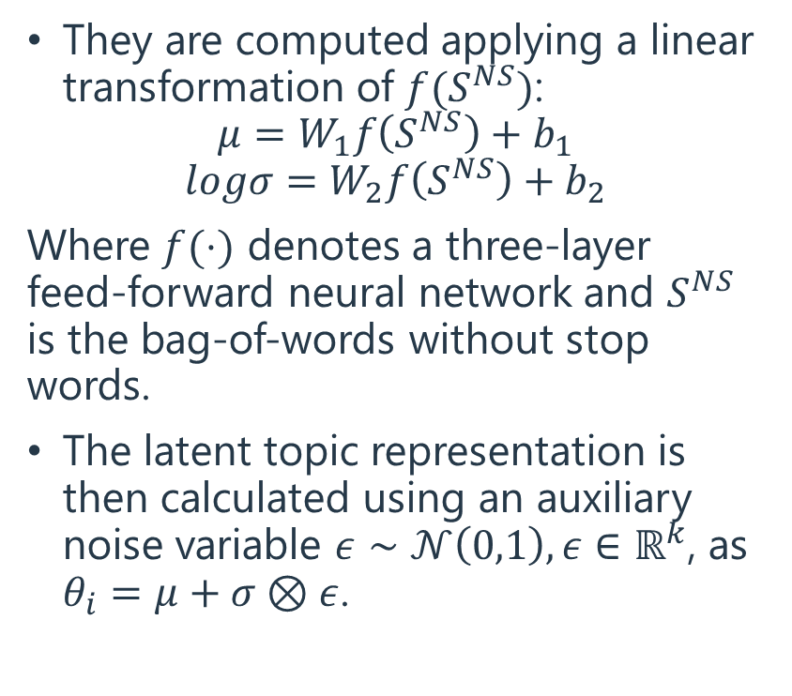
Topic inference (2)
They are computed applying a linear transformation of $f(S^{NS})$:
$$μ=W_{1}f\left(S^{NS}\right)+b_{1}$$
$$logσ=W_{2}f\left(S^{NS}\right)+b_{2}$$
Where $f(⋅)$ denotes a three-layer feed-forward neural network and $S^{NS}$ is the bag-of-words without stop words.
The latent topic representation is then calculated using an auxiliary noise variable $ε∼𝒩\left(0,1\right), ε∈ℝ^{k}$, as $θ_{i}=μ+σ⊗ε$.

Slide 12
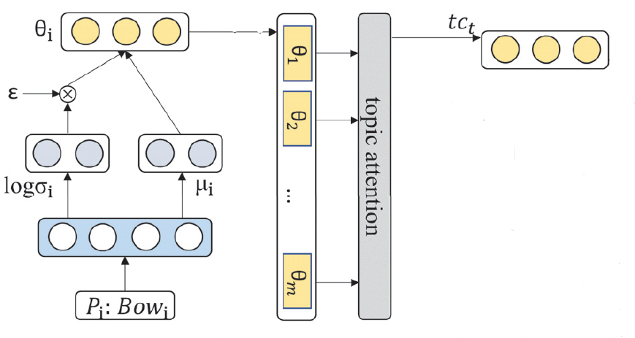
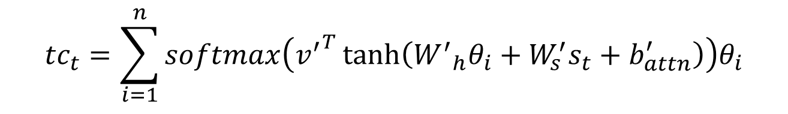
Encoder (topic attention)
Attention is also applied to paragraph-level information.
Topic attention induce the model to take notice of diverse subtopics in the decoding process.
Similarly to document-level attention, the topic context vector is obtained as:
$${tc}_{t}=\sum_{i=1}^{n}{softmax\left({v^{′}}^{T}\tanh\left({W^{′}}_{h}θ_{i}+W_{s}^{′}s_{t}+b_{attn}^{′}\right)\right)θ_{i}}$$

Slide 13
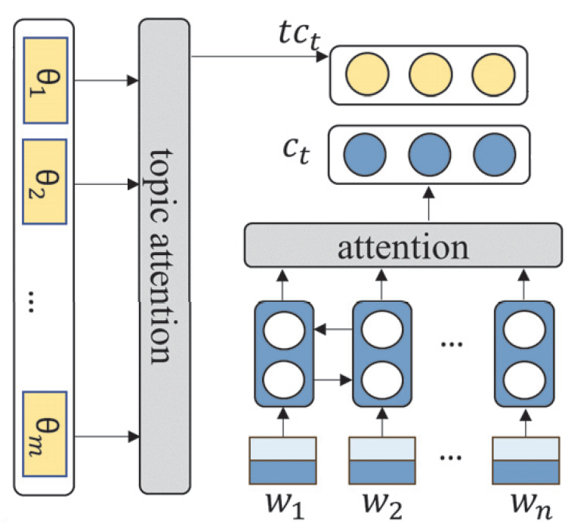
Encoder (full)

Slide 14
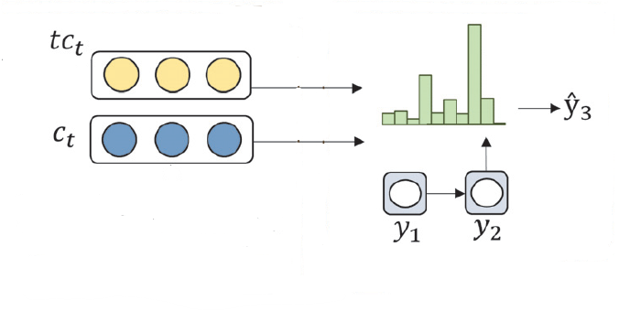
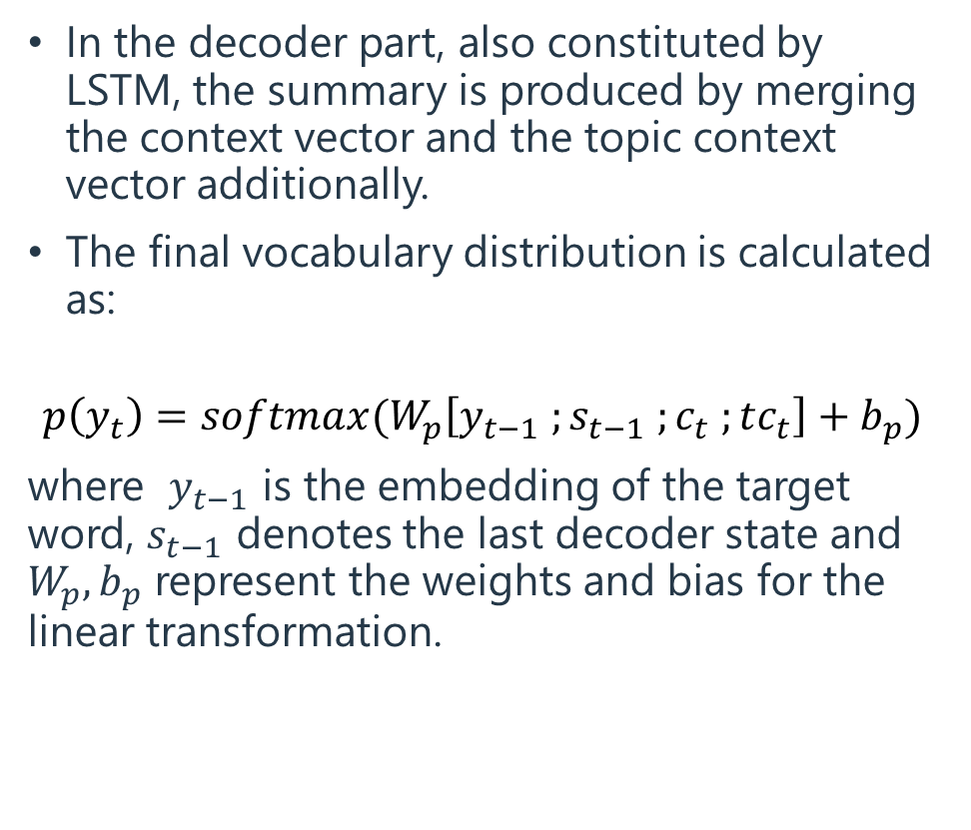
Decoder
In the decoder part, also constituted by LSTM, the summary is produced by merging the context vector and the topic context vector additionally.
The final vocabulary distribution is calculated as:
$$p\left(y_{t}\right)=softmax(W_{p}\left[y_{t−1} ;s_{t−1} ;c_{t} ;tc_{t}\right]+b_{p})$$
where $y_{t−1}$ is the embedding of the target word, $s_{t−1}$ denotes the last decoder state and $W_{p}, b_{p}$ represent the weights and bias for the linear transformation.

Slide 15
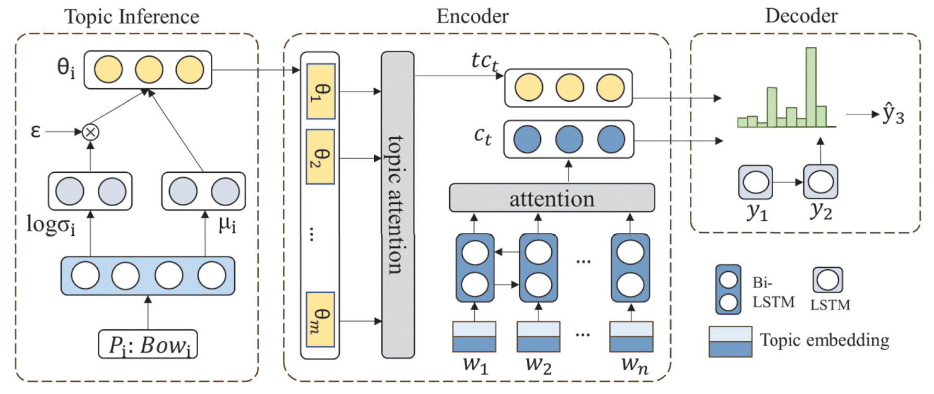
VHTM

Slide 16
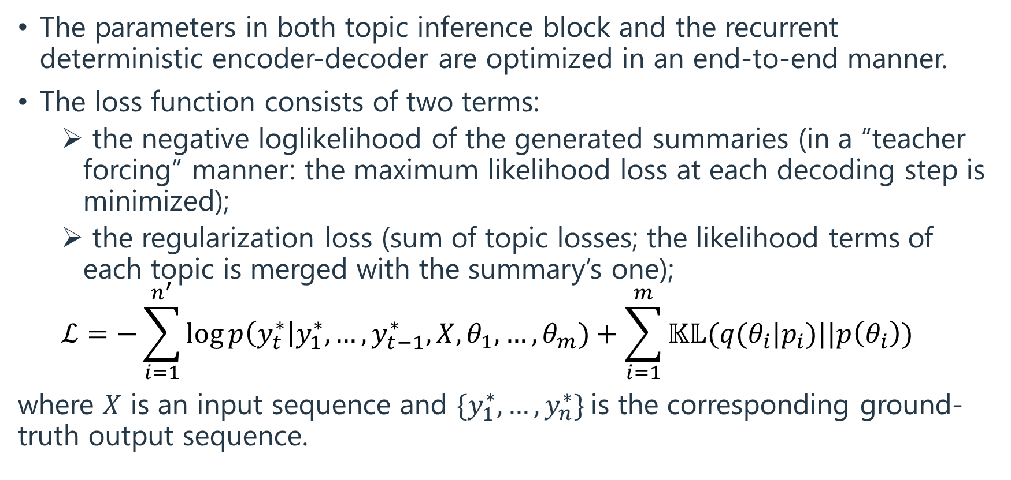
Loss
The parameters in both topic inference block and the recurrent deterministic encoder-decoder are optimized in an end-to-end manner.
The loss function consists of two terms:
the negative loglikelihood of the generated summaries (in a “teacher forcing” manner: the maximum likelihood loss at each decoding step is minimized);
the regularization loss (sum of topic losses; the likelihood terms of each topic is merged with the summary’s one);
$$ℒ=−\sum_{i=1}^{n^{′}}{\log{p\left(y_{t}^{∗}\right|y_{1}^{∗},…, y_{t−1}^{∗}, X,θ_{1},…,θ_{m})}}+\sum_{i=1}^{m}{𝕂𝕃(q(θ_{i}|p_{i})||p\left(θ_{i}\right))}$$
where $X$ is an input sequence and $\{y_{1}^{∗},…,y_{n}^{∗}\}$is the corresponding ground-truth output sequence.

Slide 17
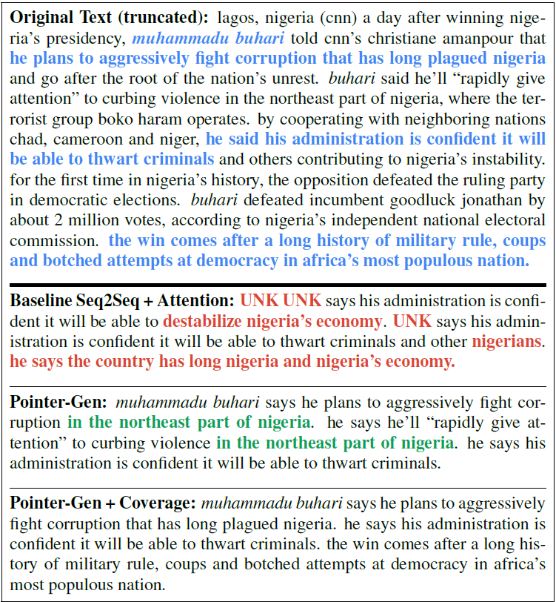
Dataset
The Dataset used for training and testing the model is the CNN/Daily Mail (a version which doesn’t require pre-processing).
It comprises online news documents (761 tokens on average) paired with multi-sequence summaries (46 tokens on average).
It contains 287.226 training pairs, 13.368 validation pairs, 11.490 test pairs.

Slide 18
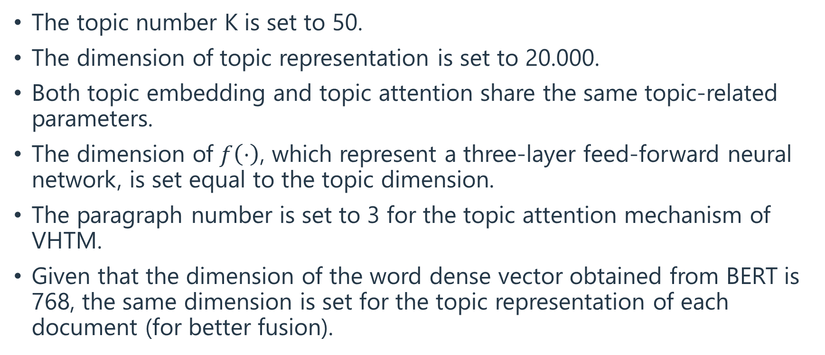
Experimental setting
The topic number K is set to 50.
The dimension of topic representation is set to 20.000.
Both topic embedding and topic attention share the same topic-related parameters.
The dimension of $f\left(⋅\right)$, which represent a three-layer feed-forward neural network, is set equal to the topic dimension.
The paragraph number is set to 3 for the topic attention mechanism of VHTM.
Given that the dimension of the word dense vector obtained from BERT is 768, the same dimension is set for the topic representation of each document (for better fusion).

Slide 19
Evaluation
The metric system used is ROUGE (Recall-Oriented Understudy for
Gisting Evaluation).
It calculates the overlaps between peer and model summaries in different ways.
In particular, three different metric were applied here:
ROUGE-1, to evaluate the overlapping of one word (% of matching word per sequence);
ROUGE-2, to evaluate the overlapping of bi-grams (% of matching subsequences of 2 words per sequence);
ROUGE-L F-score, to evaluate the length of the longest common subsequence.

Slide 20
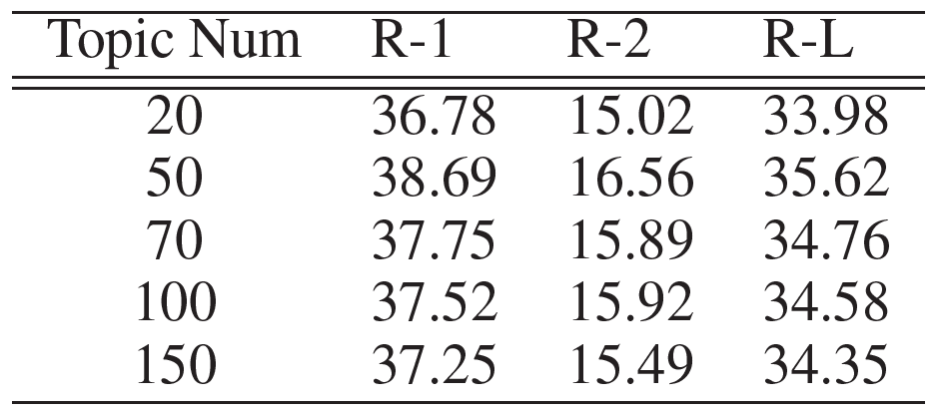
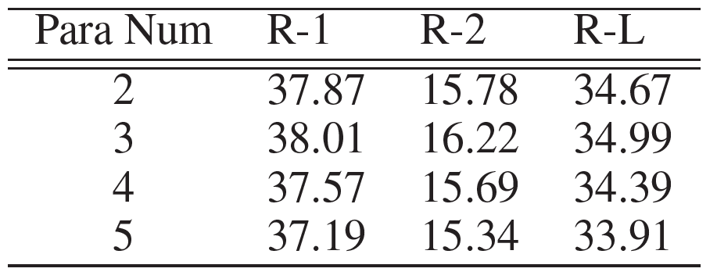
Hyperparameters tuning

Slide 21
State of the Art (selected)
Words-lvt2k-temp-att (Nallapati et al. 2016)
It models abstractive text summarization using an attentional encoder-decoder recurrent neural network (baseline for most others).
ConvS2S + fixed control (Fan, Grangier, and Auli 2017)
It introduces a controlled summarization model (constant value for length and source-style).
Pg + cov (See, Liu, and Manning 2017)
It proposes a hybrid pointer-generator network to deal with Out-Of-Vocabulary words problem and designs coverage mechanism to avoid words repetition.
Pg + EG + QG (Guo, Pasunuru, and Bansal 2018)
It applies multi-task learning with the auxiliary tasks of question generation and entailment generation, leading to salient questioning-worthy details and ability of rewriting.
Pg + GAN (Liu et al. 2018)
Pg + cbdec (Jiang and Bansal 2018)
It adds an additional “closed book” decoder, forcing the encoder to be more selective in the information encoded in its memory state.

Slide 22
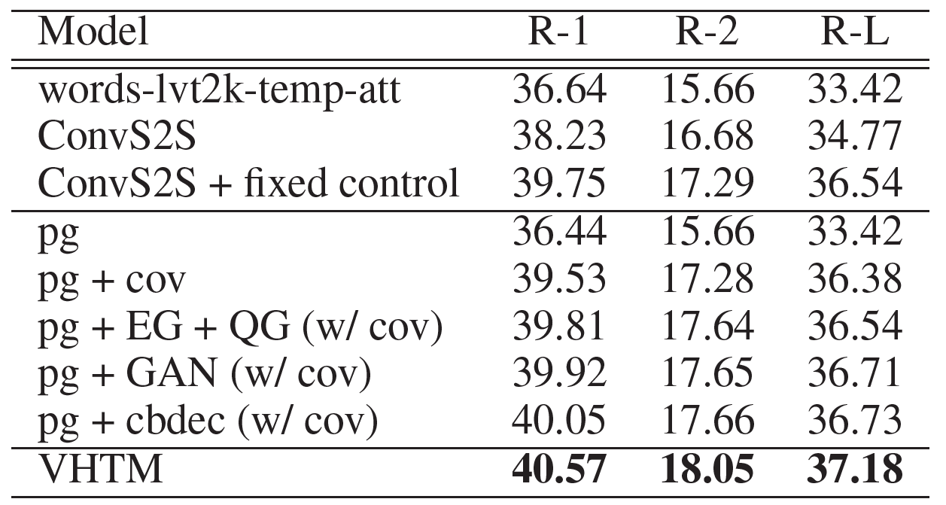
Results*
*The current state-of-the art model is a hierarchical attention transformer (HAT-BART) characterized by a sequence-level attention mechanism, which obtains the following ROUGE scores, respectively: 44.48; 21.31; 41.52 (Rohde, Wu and Liu 2021)

Slide 23
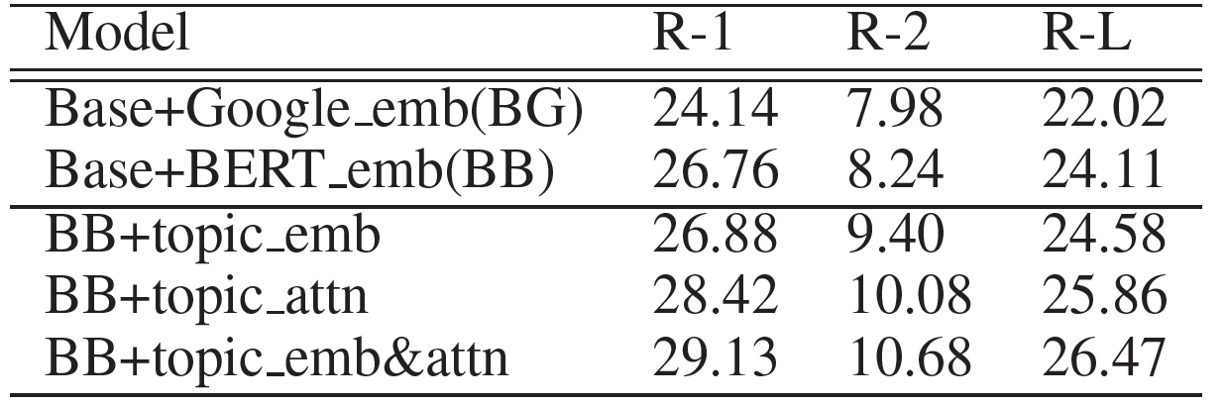
Ablation study
The baseline is a sequence-to-sequence model accompanied with traditional attention mechanism. In the first block it is tested with pre-trained word dense embedding from Google (BG) and BERT extension (BB).
Then the model are equipped with the hierarchical topic-aware mechanism, namely topic embedding (BB+topic_emb) and topic attention (BB+topic_attn) separately. Their mixture (BB+topic_emb&attn) retains the higher ROUGE scores.

Slide 24
Conclusion (1)
The variational hierarchical topic-aware model tackles the task of summarizing long texts by simultaneously extracting and summarizing topic information with a variational encoder-decoder framework as well as combining the hierarchical topic contents via embedding and paragraph attention.

Slide 25
Conclusion (2)
Topic embedding is beneficial for uni-gram generation, even if achieves only slight improvements w.r.t. the state of the art. Authors speculate that current language models have already captured significant semantic information for uni-grams.
Instead bi-grams, in particular, can benefit from assistance given by topic materials. A possible way of obtaining more n-gram matchings is indeed by using topic attention on paragraphs, which we have seen significantly improve the performance under all ROUGE metrics.

